Slide 1

Reviews Analysis

Slide 2
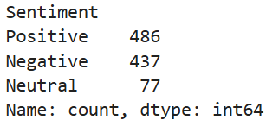
British Airways Reviews
Analysis
Types of sentiment distribution :-

Slide 3
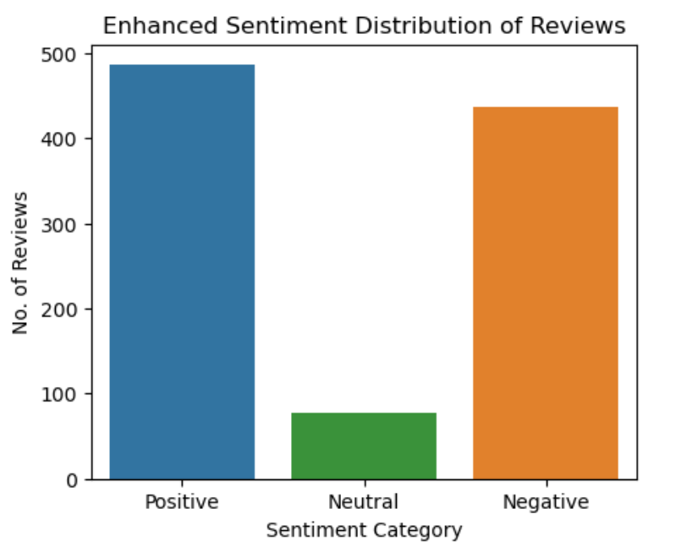
Sentiment distribution bar plot :-

Slide 4
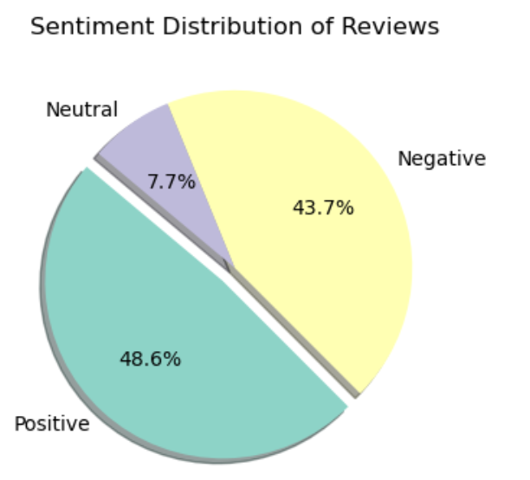
Pie chart sentiment distribution(%) :-

Slide 5
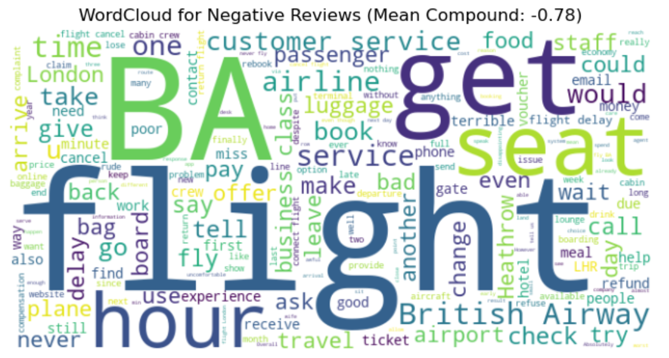
Wordcloud with sentiment intensity :- (Understand negative reviews)

Slide 6
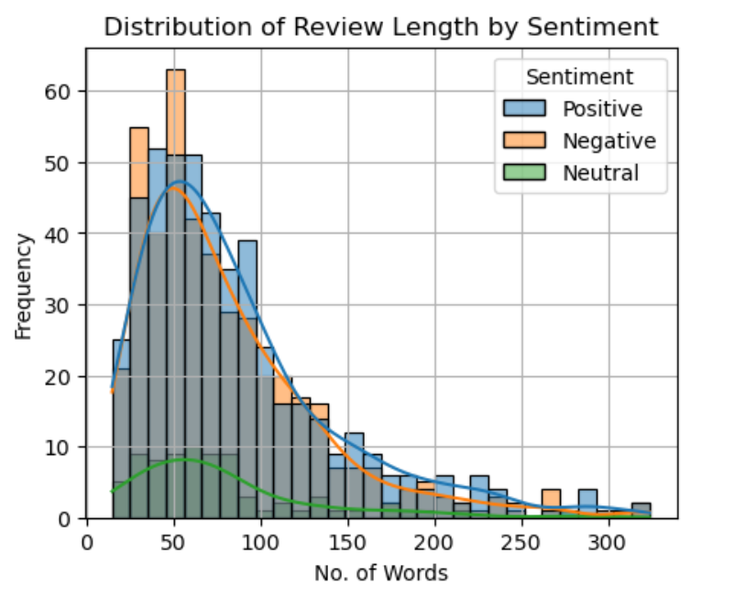
Review length analysis with sentiment :-

Slide 7
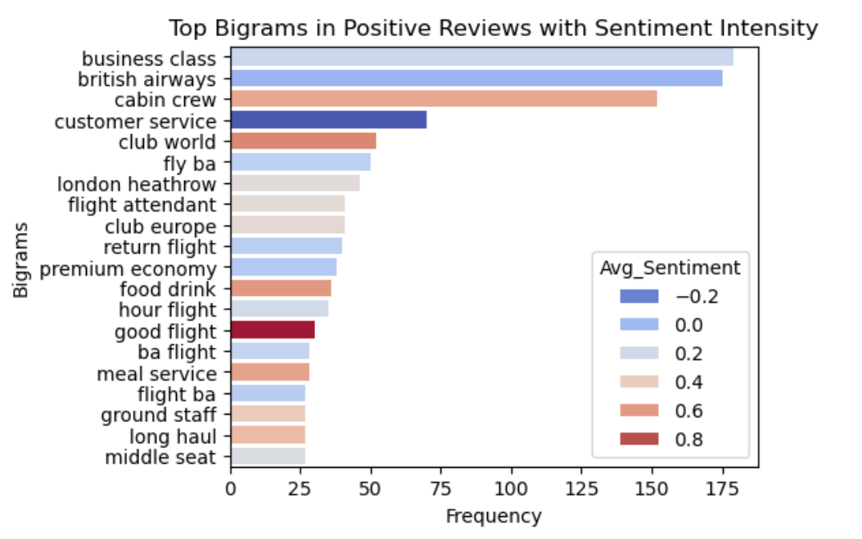
Enhanced bigram analysis with context :-
Positive reviews analysis

Slide 8
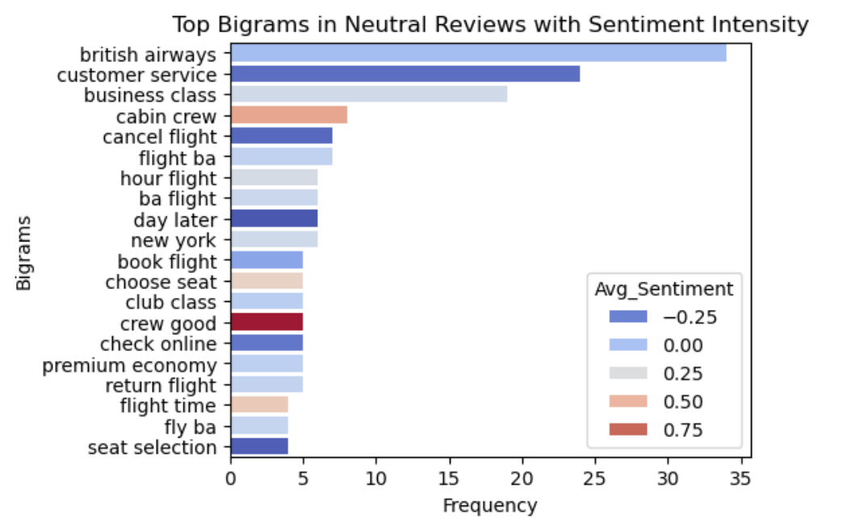
2. Neutral reviews analysis

Slide 9
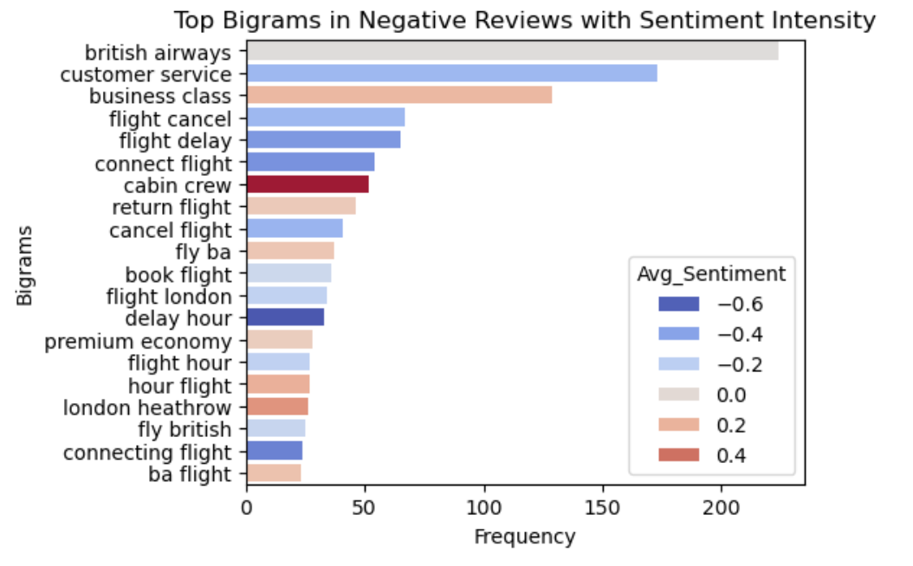
3. Negative reviews analysis

Slide 10
Customer Prediction

Slide 11
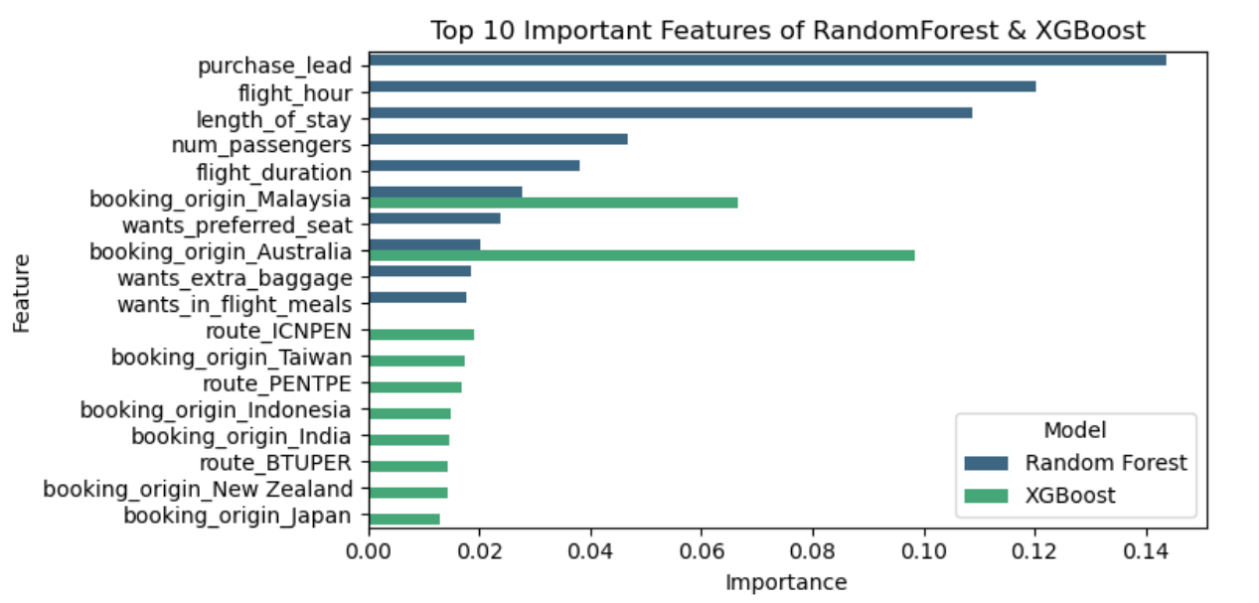
Top 10 Important features of RandomForest and XGBoost

Slide 12
Features Importance Summary
The chart display the top 10 most influential features identified by two classification models --- Random Forest and XGBoost --- in predicting customer behavior(likely related to booking or delay prediction).
Random Forest :-
purchase_lead, flight_hour and length_of_stay are the most critical predictors, indicating the importance of timing and trip duration in customer decisions.
num_passengers and flight_duration also rank high, showing how group size and travel_time influence behavior.

Slide 13
XGBoost :-
Places significant importance on booking_origin, especially from countries like Australia, Malaysia, and Taiwan, indicating geographic location as a strong determinant.
Specific routes (e.g., ICNPEN, PENTPE, BTUPER) also emerge as key features, suggesting route popularity or operational efficiency may influence the target behavior.

Slide 14
Dataset Overview
Source: Airline customer booking dataset (50,000 records), And duplicates values are (719), Total data = 49281.
And also there are 14 columns and 49281 rows in a dataset.
Dataset type: Tabular customer booking record for an airline, possibly related to predicting flight behaviours (like no-shows or cancellations)
There are non-null value in dataset and dtypes are ‘int, float, object’ .

Slide 15
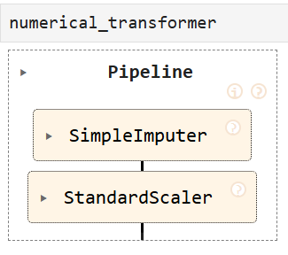
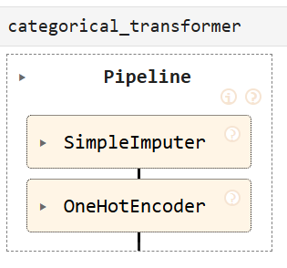
Preprocessing pipeline
Numerical transformer:- Only numeric columns will used to StandardScaler .
Categorical transformer:- Only category columns will used to OneHotEncoder.

Slide 16
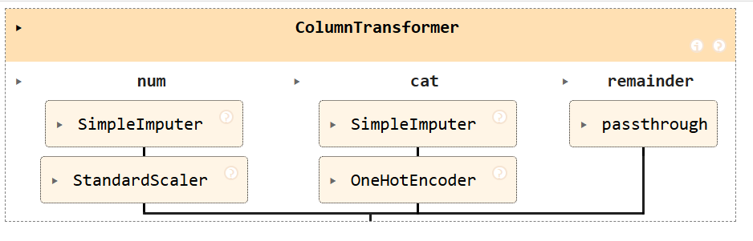
Combine both numerical & categorical transformer

Slide 17
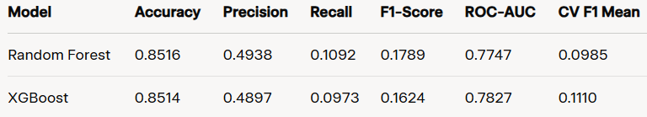
Model Comparison Table
Random Forest Classifier perform slightly better than XGBoost Classifier due to Accuracy, Precision, Recall, F1-Score.
XGBoost Classifier perform slightly less than than RandomForestClassifier due to ROC-AUC score, CV F1 Mean

Slide 18
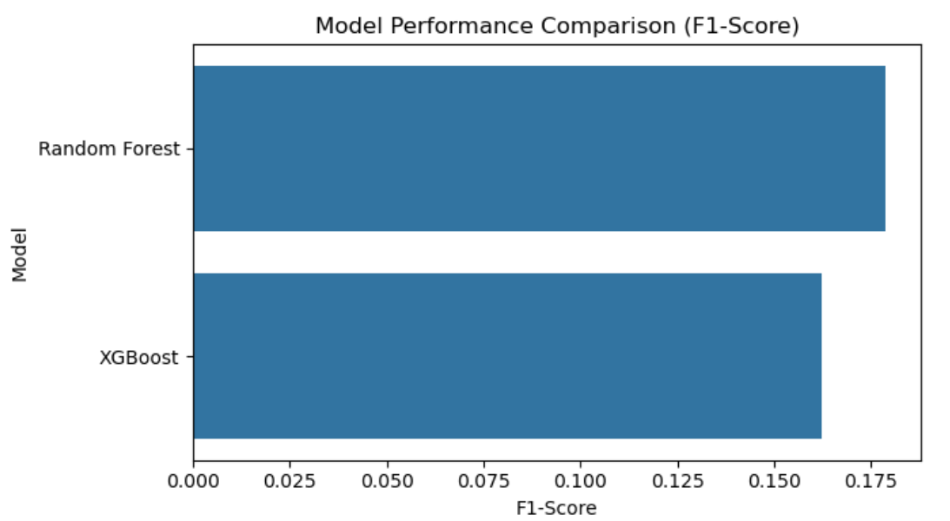
Analyze a both model performance

